Slide 1
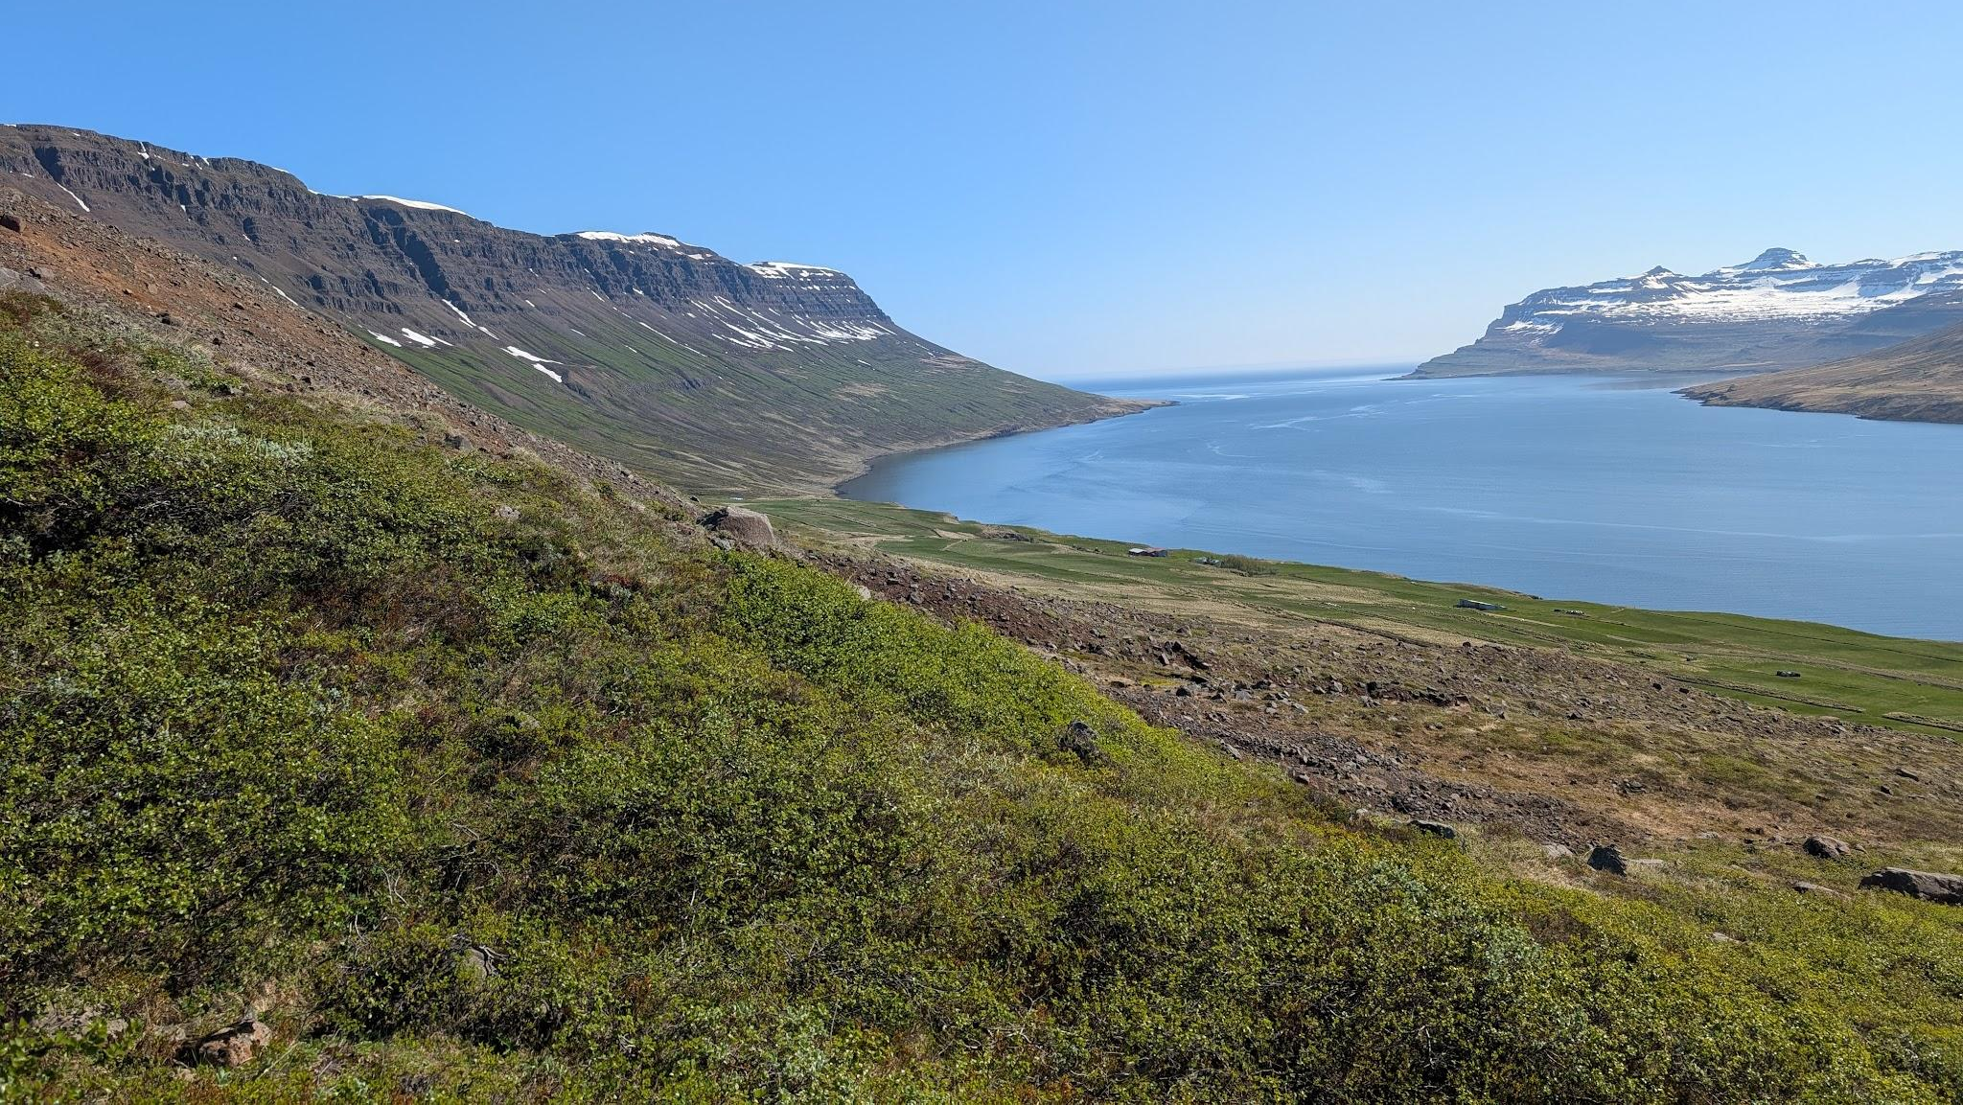
A preliminary hydrogeological investigation of debris flow characteristics in Selsstaðir, Austfirðir, Iceland
Bronte “Bleu” Stahl
SIT Iceland: Climate Change and the Arctic

Slide 2
Artificial Intelligence (AI) Use Statement
Artificial Intelligence tools, specifically ChatGPT, were employed during this research for:
Troubleshooting GIS-related tasks in ArcGIS Pro, including dataset formatting and uploading.
Assisting with R Studio code writing and troubleshooting error messages.
Sourcing relevant literature and scientific resources on perched aquifers, debris flow mechanics, and landslide modeling.

Slide 3
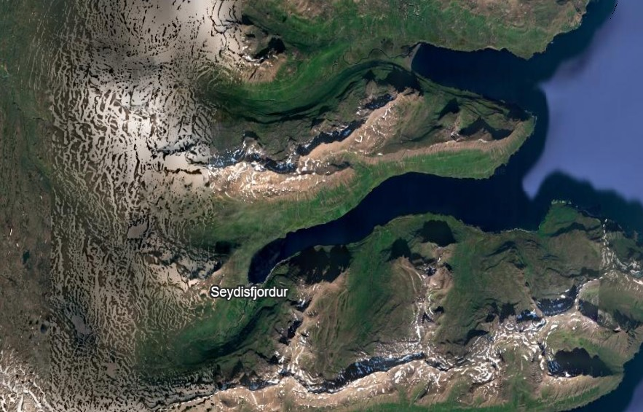
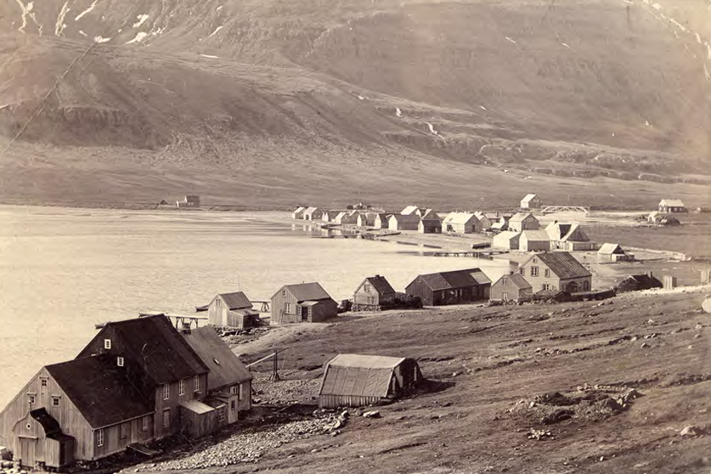
Context
Glacial retreat, sedimentary layers between tertiary bedrock
Settlement growth in 1900 = start of landslide inventory (10)
Rainfall triggered (1/3 of annual rainfall)
IMO collaboration

Slide 4
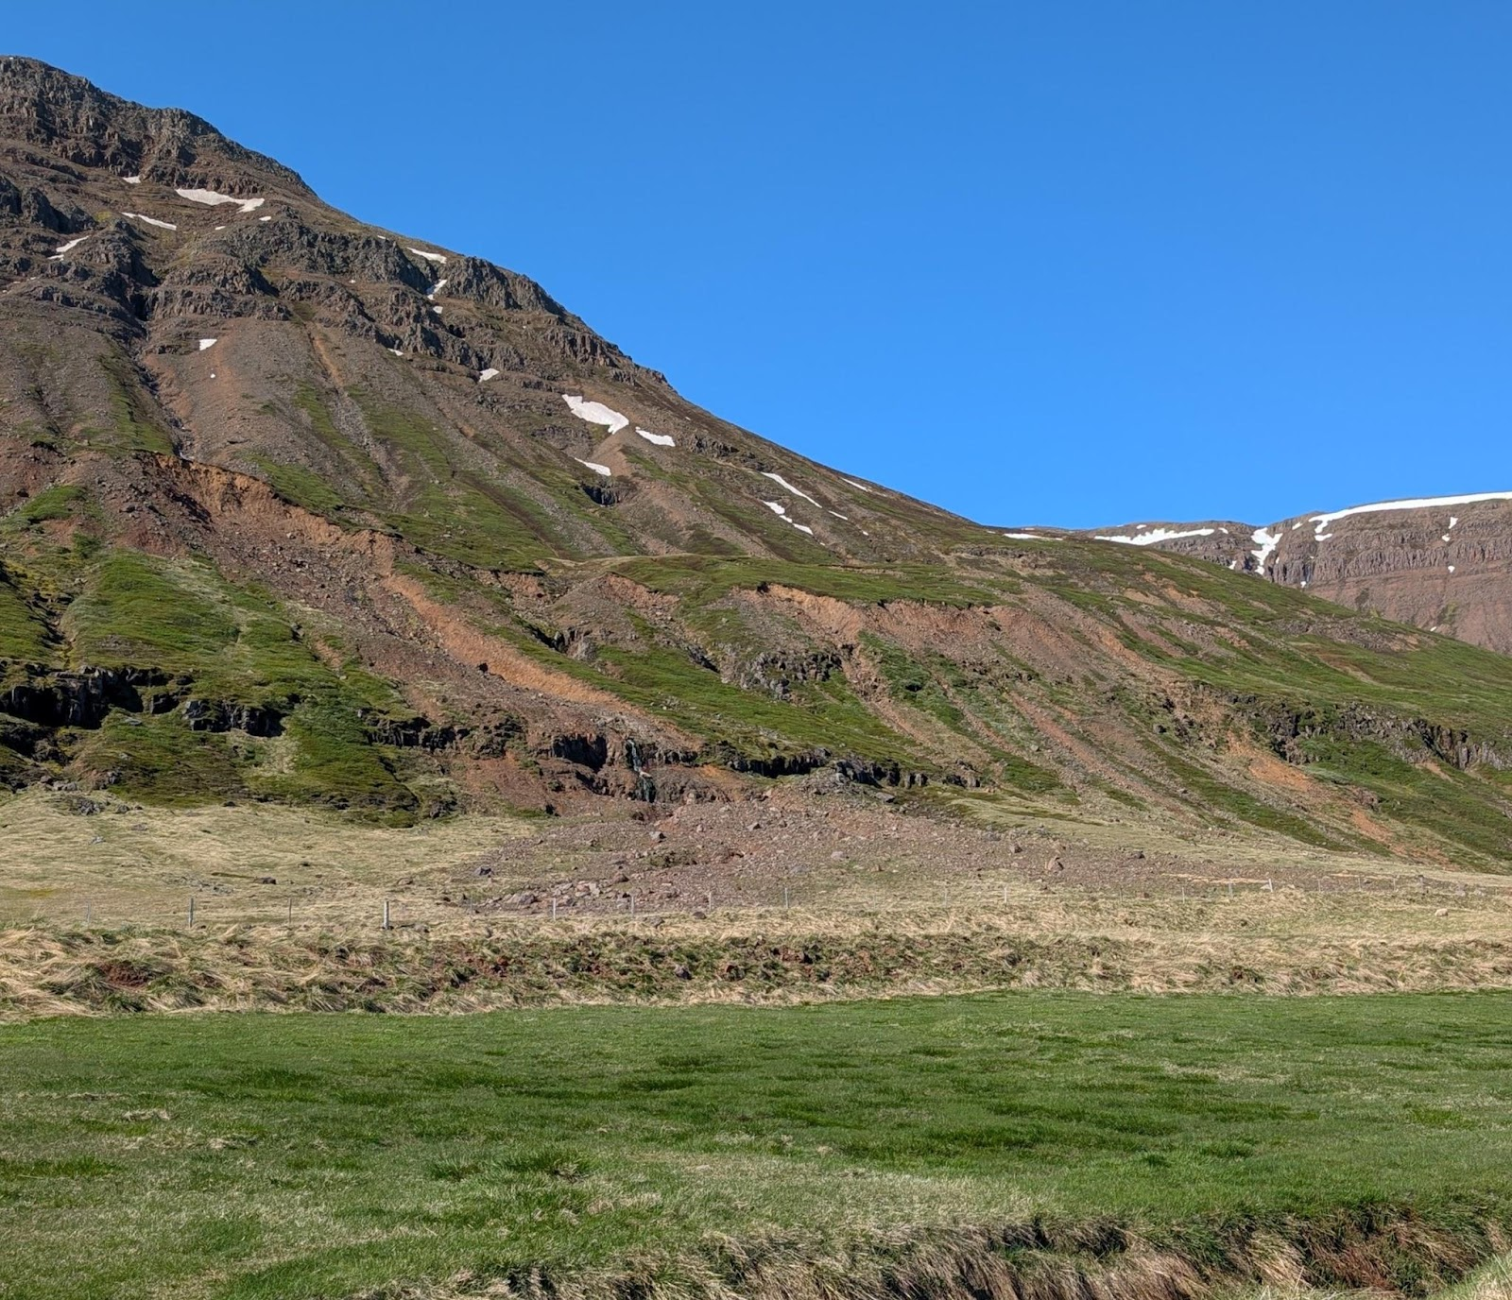
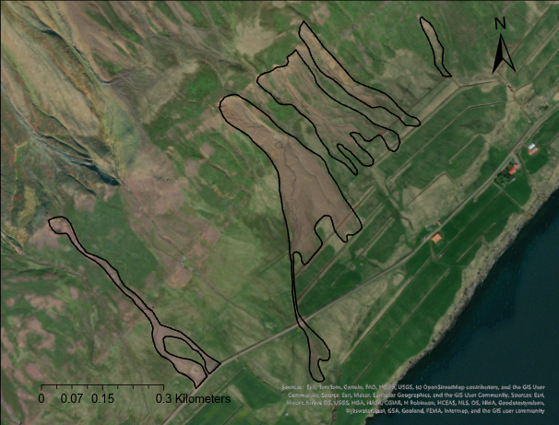
Study Area
Debris flow mechanics
Boots on the ground observations (ethics)
Skógarhjallar, Selsstaðir

Slide 5
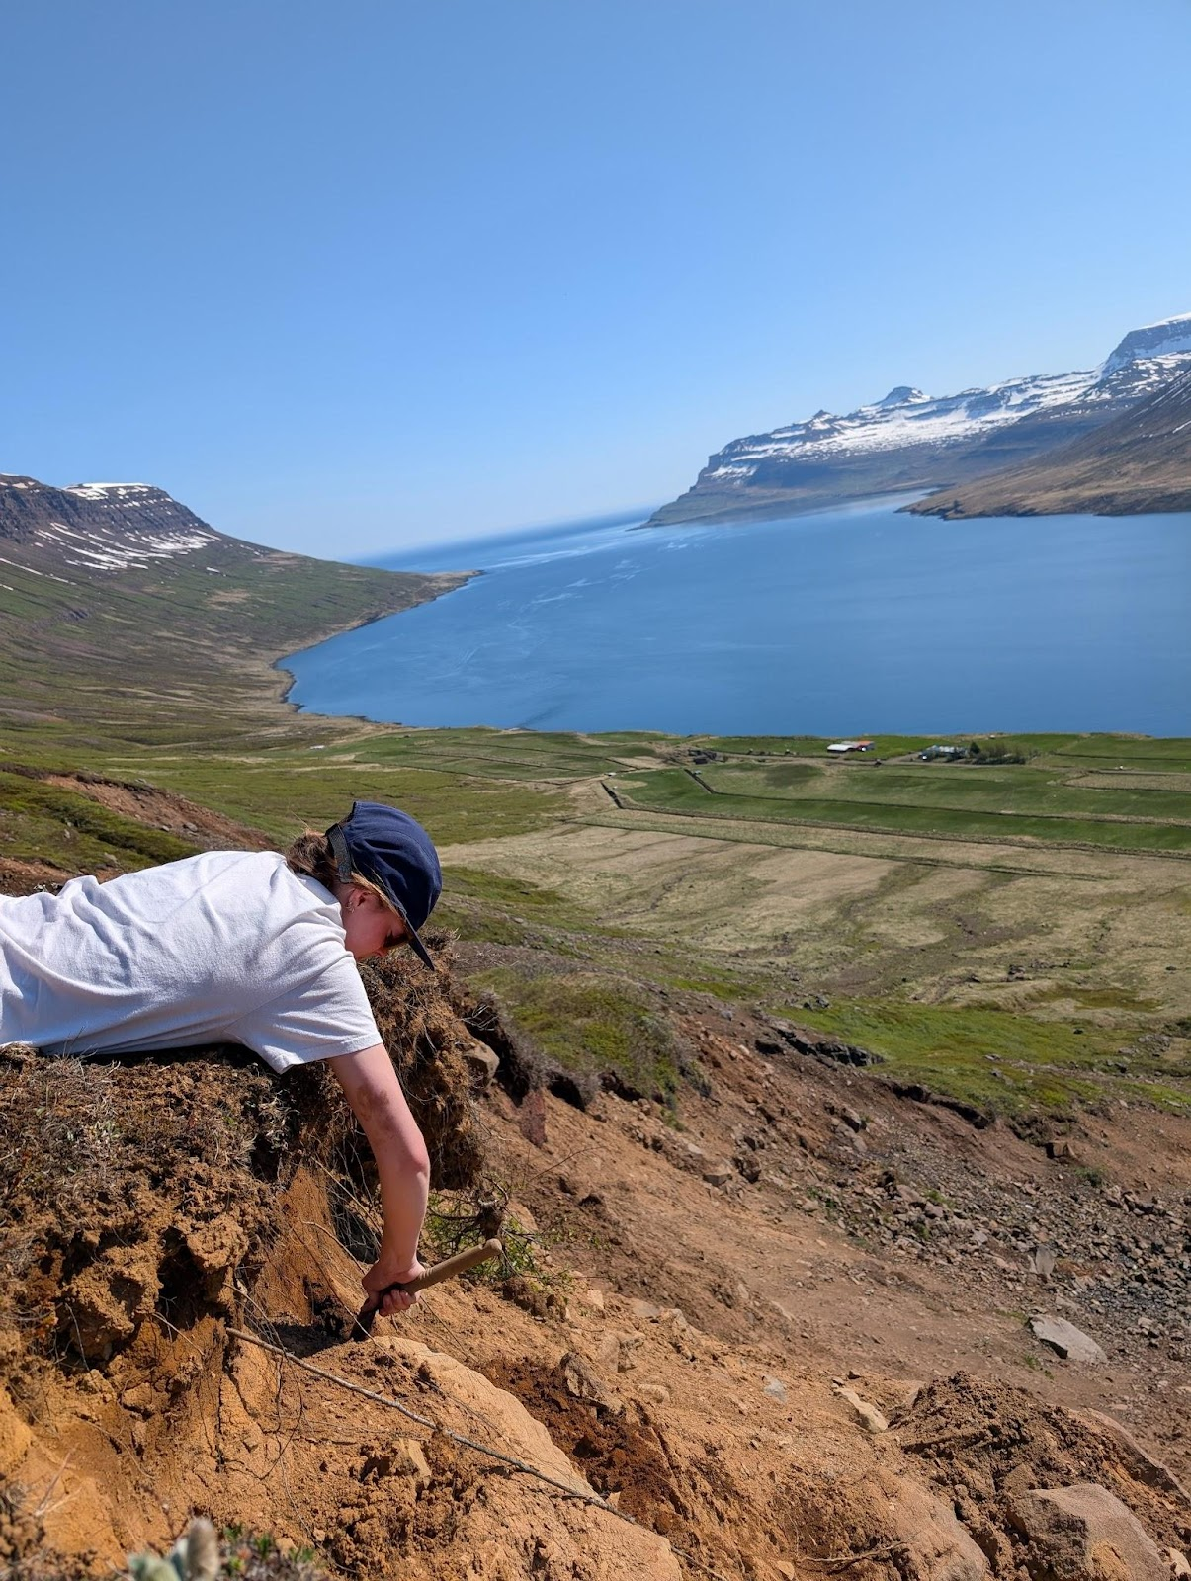
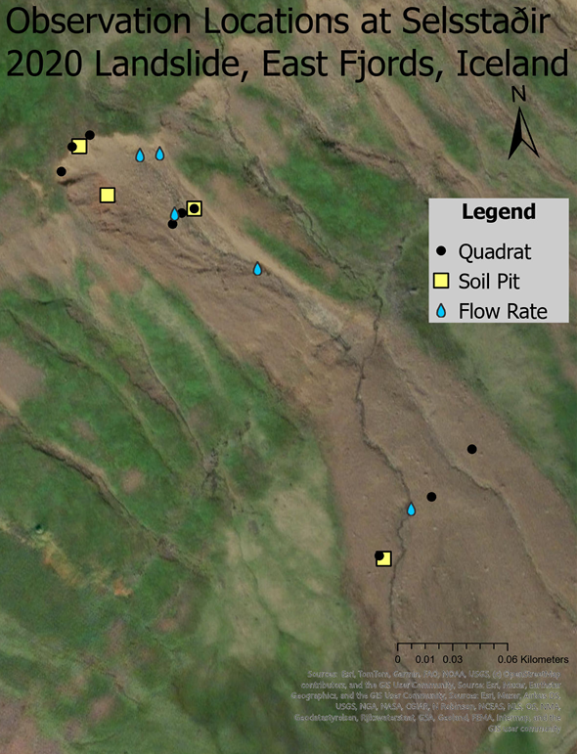
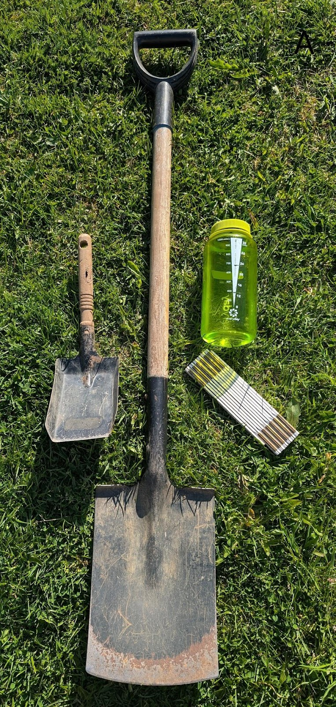
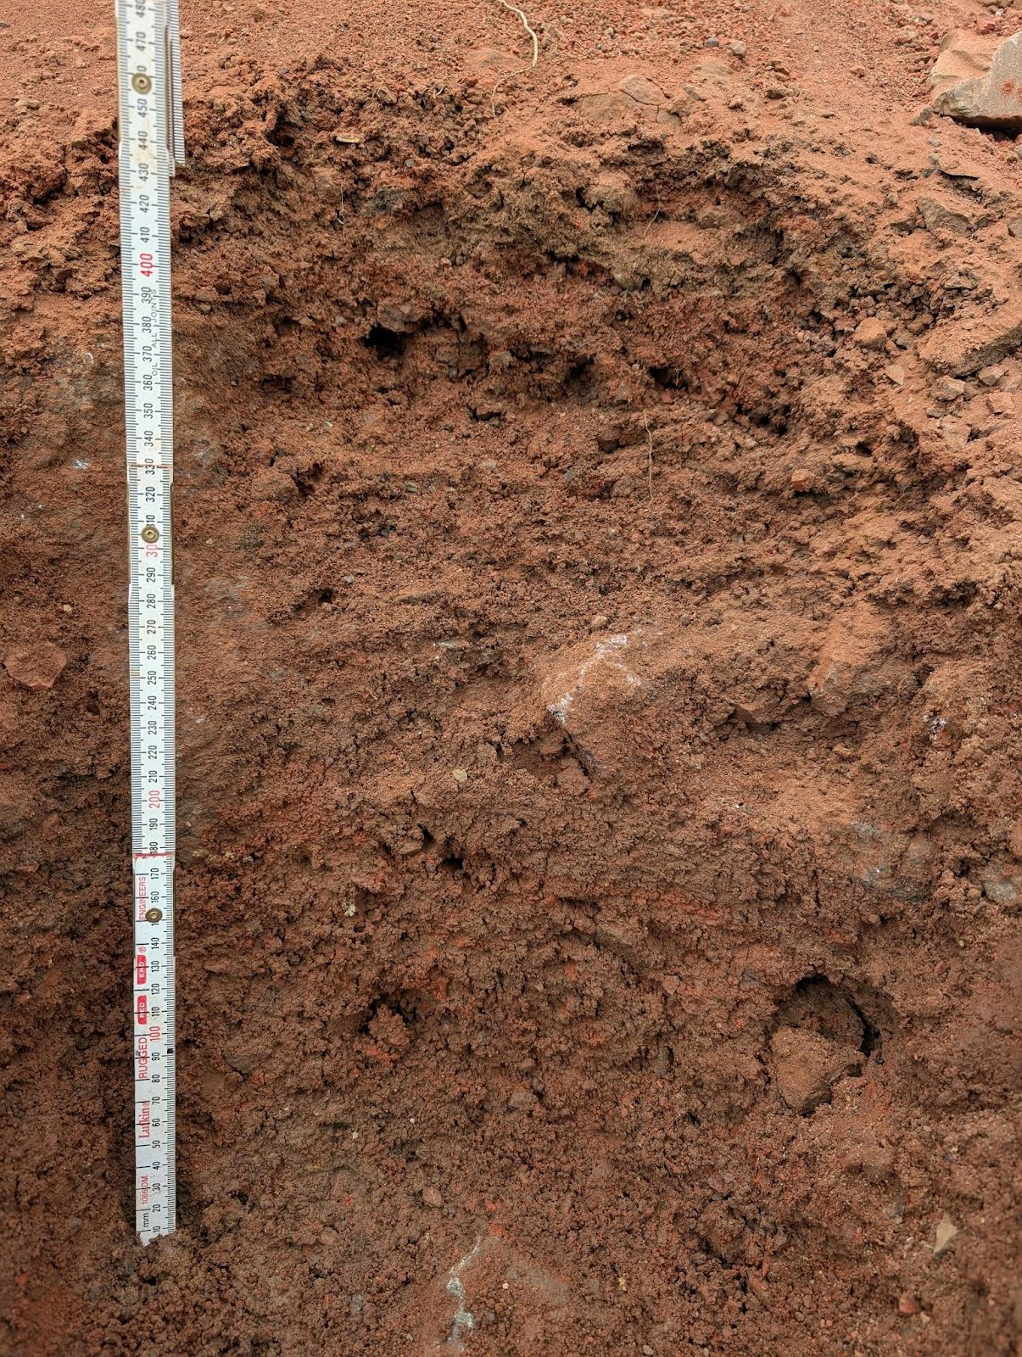
Methods
3 Locations
Soil pit
3 Quadrats
Soil size distribution (Wentworth 1922)
Soil texture by feel (Theis, 1979)
Flow rate measurement
Notes:
2D and 3D approach to identify layering patterns, hydrologic behavior, and post-landslide sediment dynamics .

Slide 6
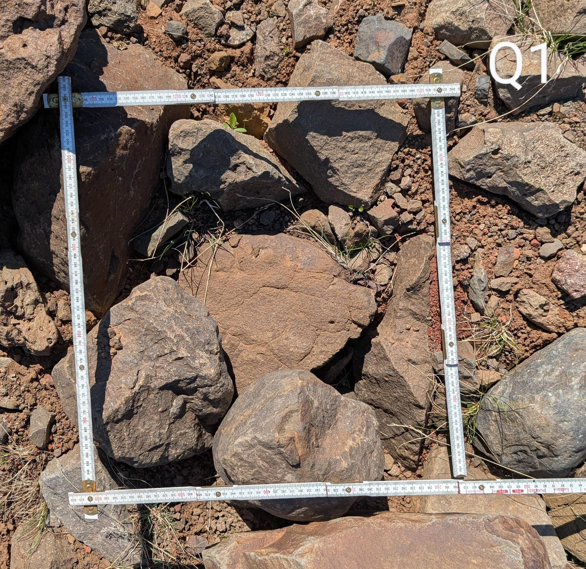
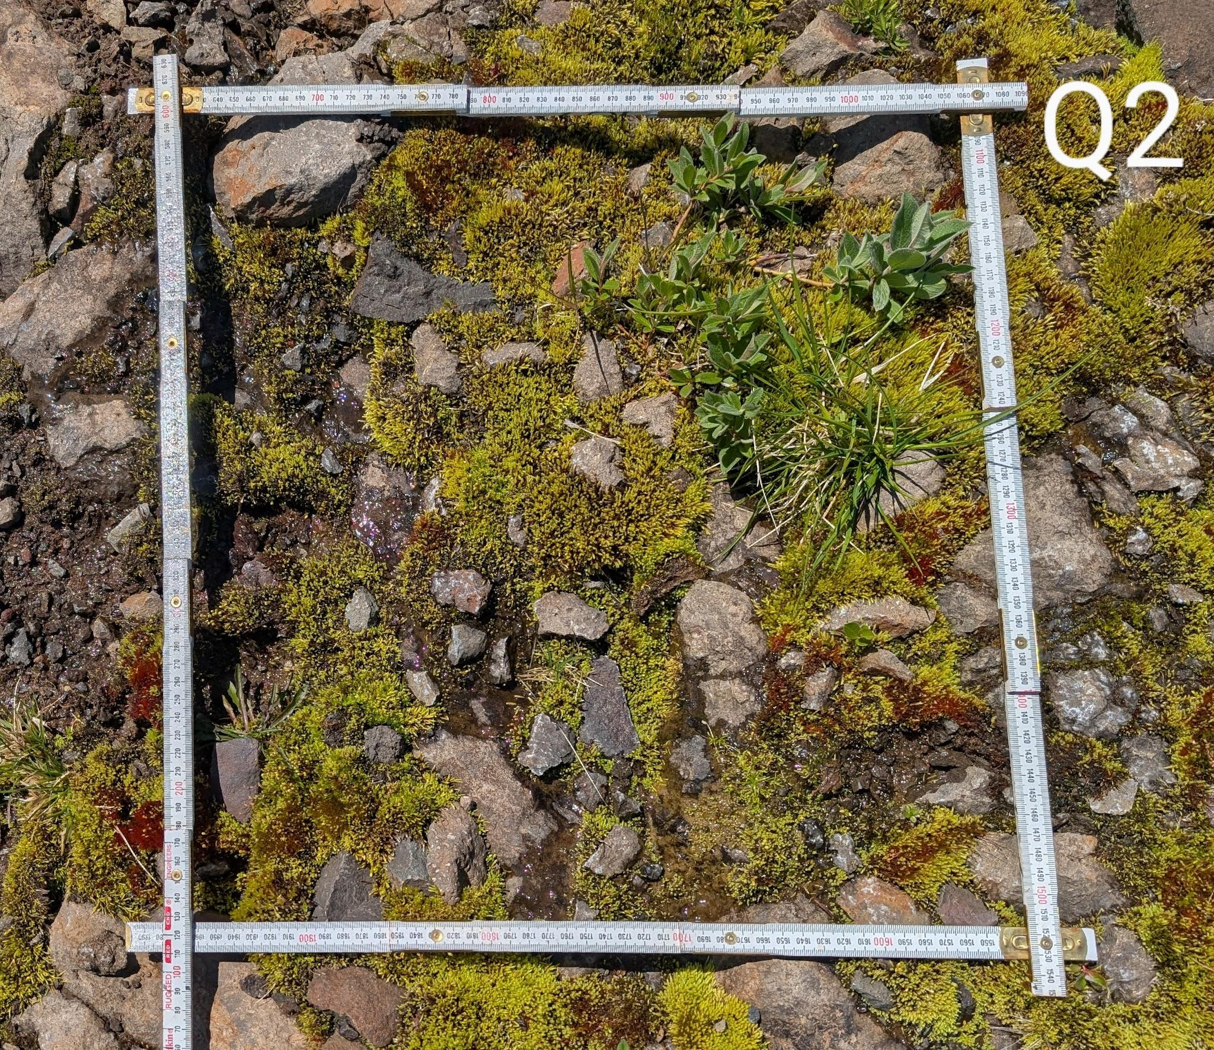
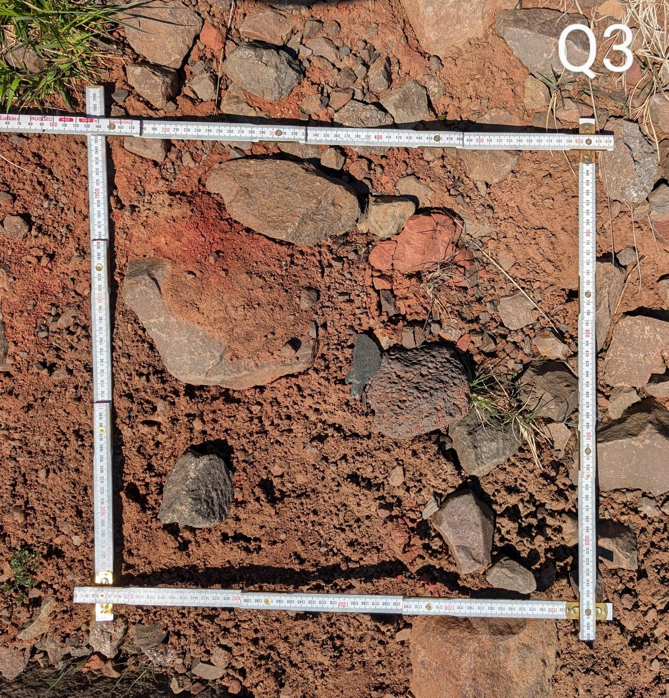
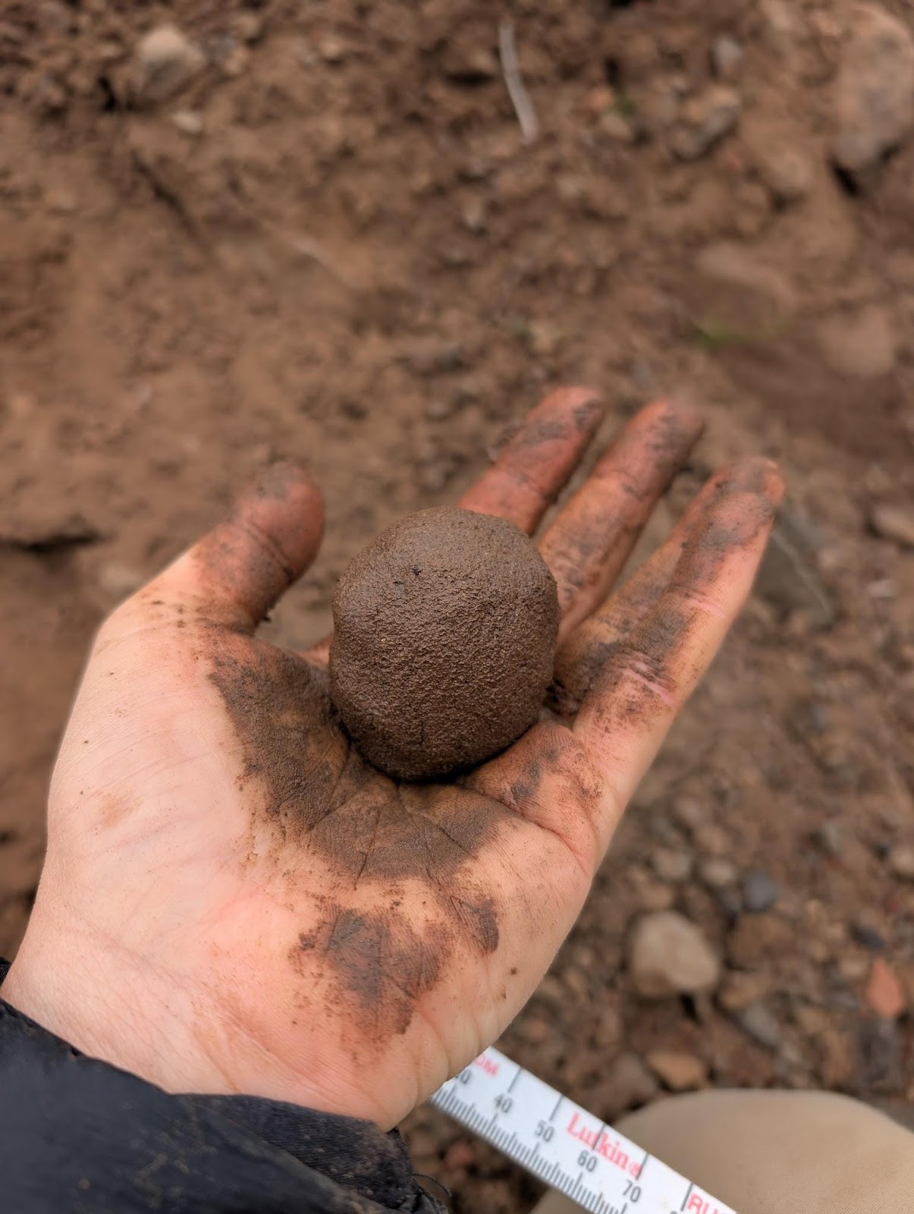
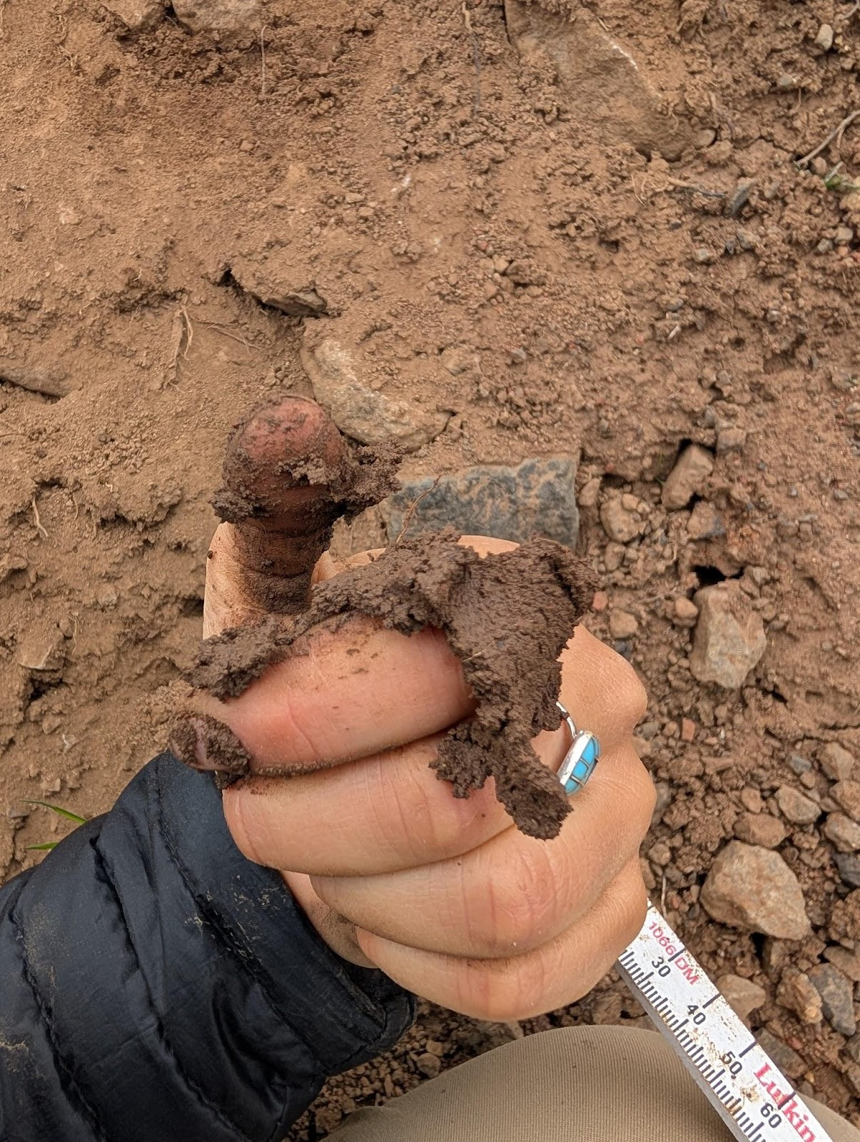
Methods
Debris flow path quadrats:
Soil texture by feel
Ball test
Ribbon test
Texture test
CLAY LOAM
Notes:
Clay Loam has high water holding capacity (fine clay particles, which have a high surface area and strong ability to attract and hold water.)

Slide 7
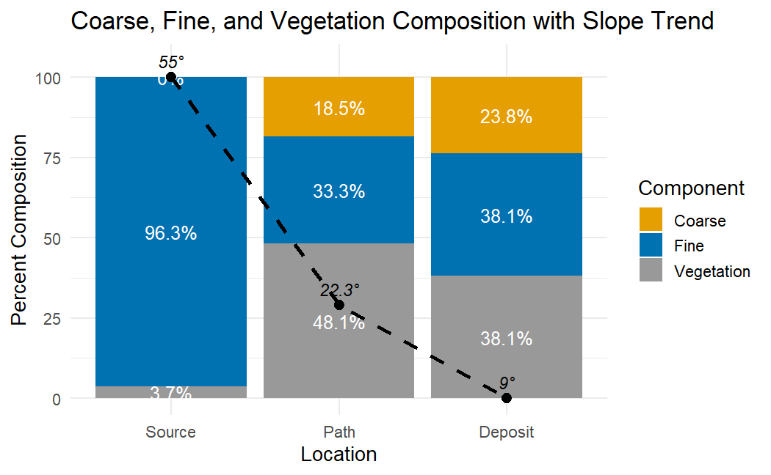
Results
Inverse relationship: coarse material and slope angle
More vegetation downslope (flow rate)
Less fine material downslope
Notes:
Figure 20 illustrates how coarse materials increase as slope angle decreases. The source area had a high percentage of fine materials because gravity caused the coarse material to fall away. The greater vegetation at the path location is related to the moist conditions of the slope from the spring fed streams. These patterns suggest that saturated fine materials from the source transitioned into higher energy flows capable of mobilizing large boulders into the lower elevations.
this is excellent. really helps me understand and points to the bigger picture
This is good to know and all, but what does it mean for the future

Slide 8
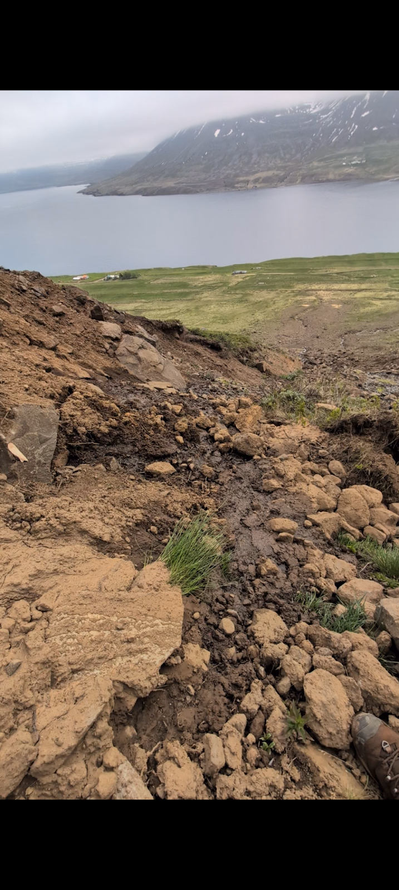
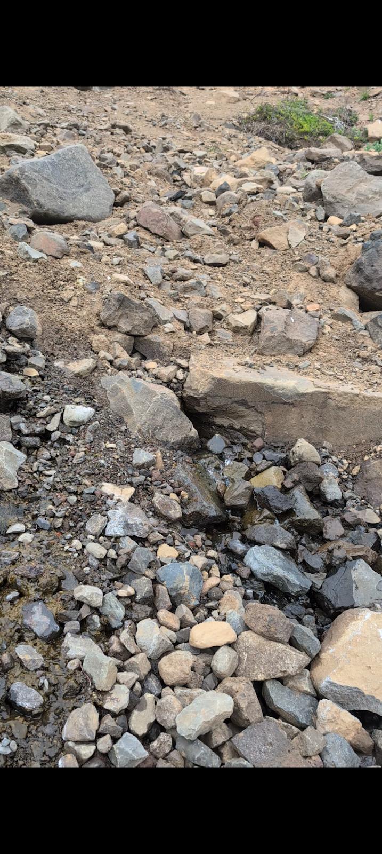
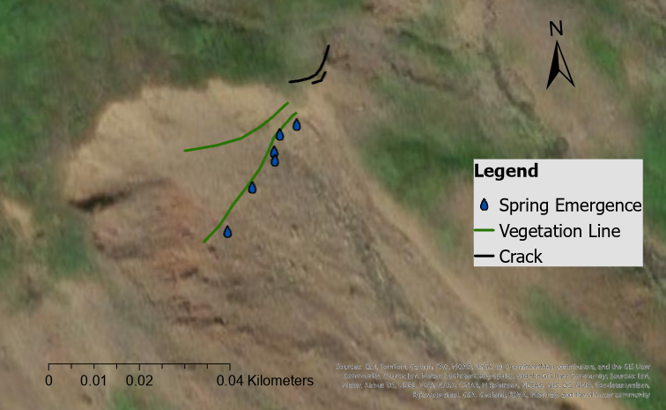
Results
6 spring emergence points
261 m a.s.l.
Lateral vegetation line
265 and 273 m a.s.l.
Cracks
265 m a.s.l.

Slide 9
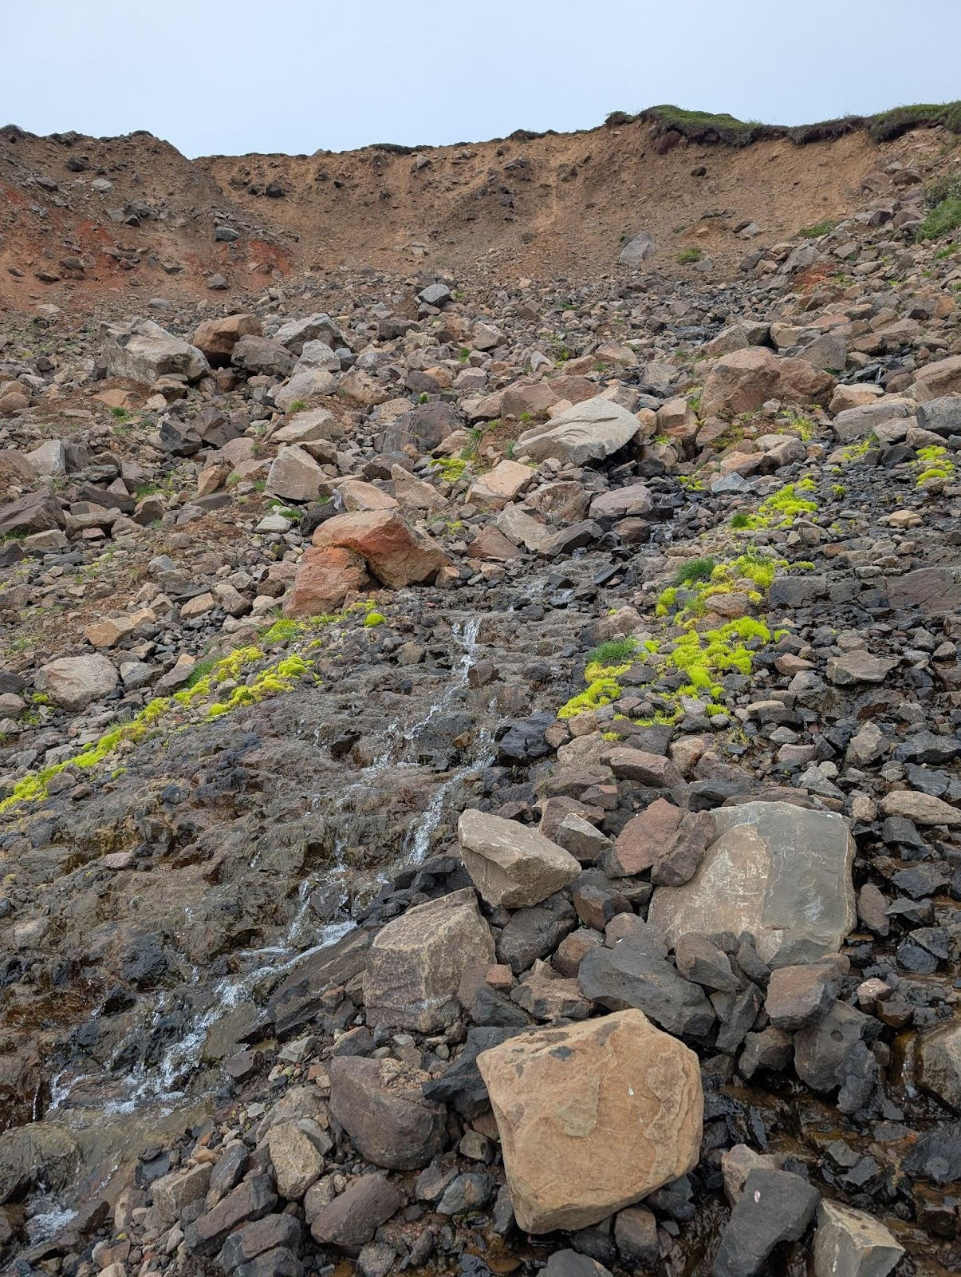
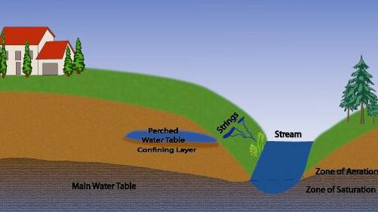
Discussion & Conclusions
Soil horizon: seasonal wetting & drying
Cracks: stress along failure plane
Perched aquifer: further research
Groundwater Dictionary

Slide 10
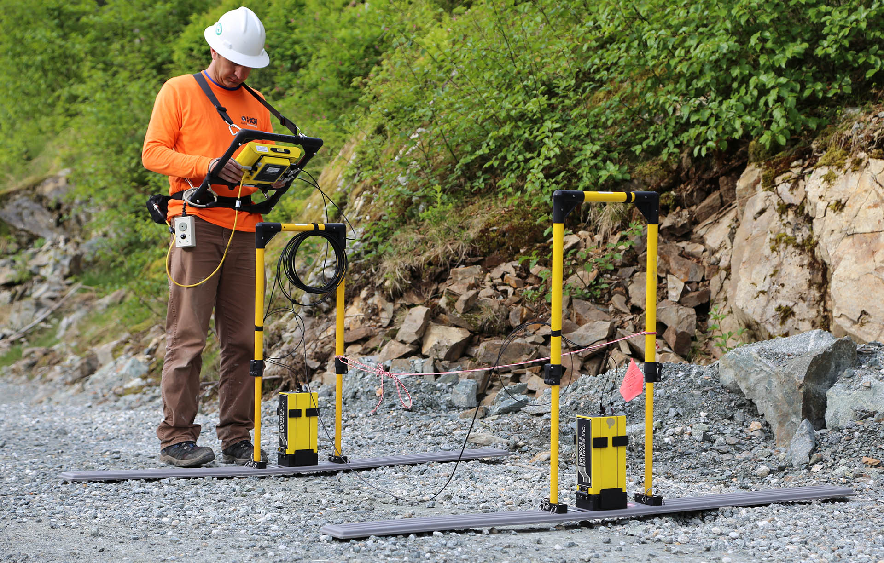
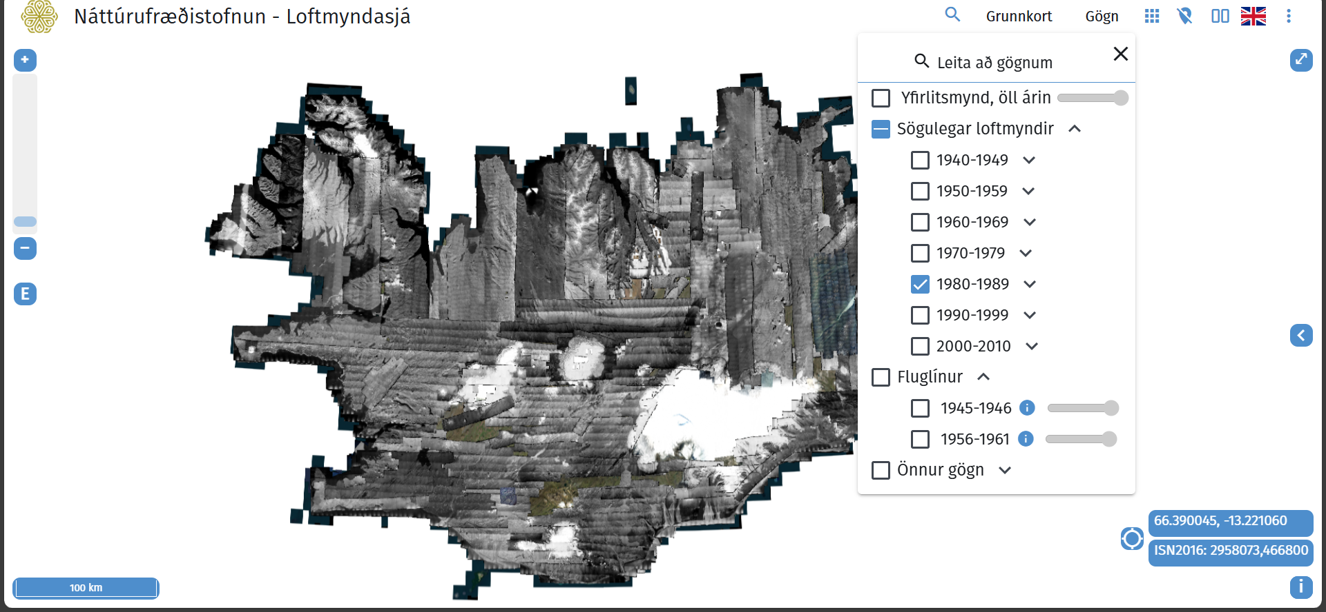
Future Research
Volume estimation
Field infiltration tests (permeability)
Ground penetrating radar (continuity of mid-layer)
Return period prediction
Water capacity and recharge rate
Hazard mapping
Modelling
Georeference historical landslides
CERTERRA
Natural Science Institute of Iceland

Slide 11
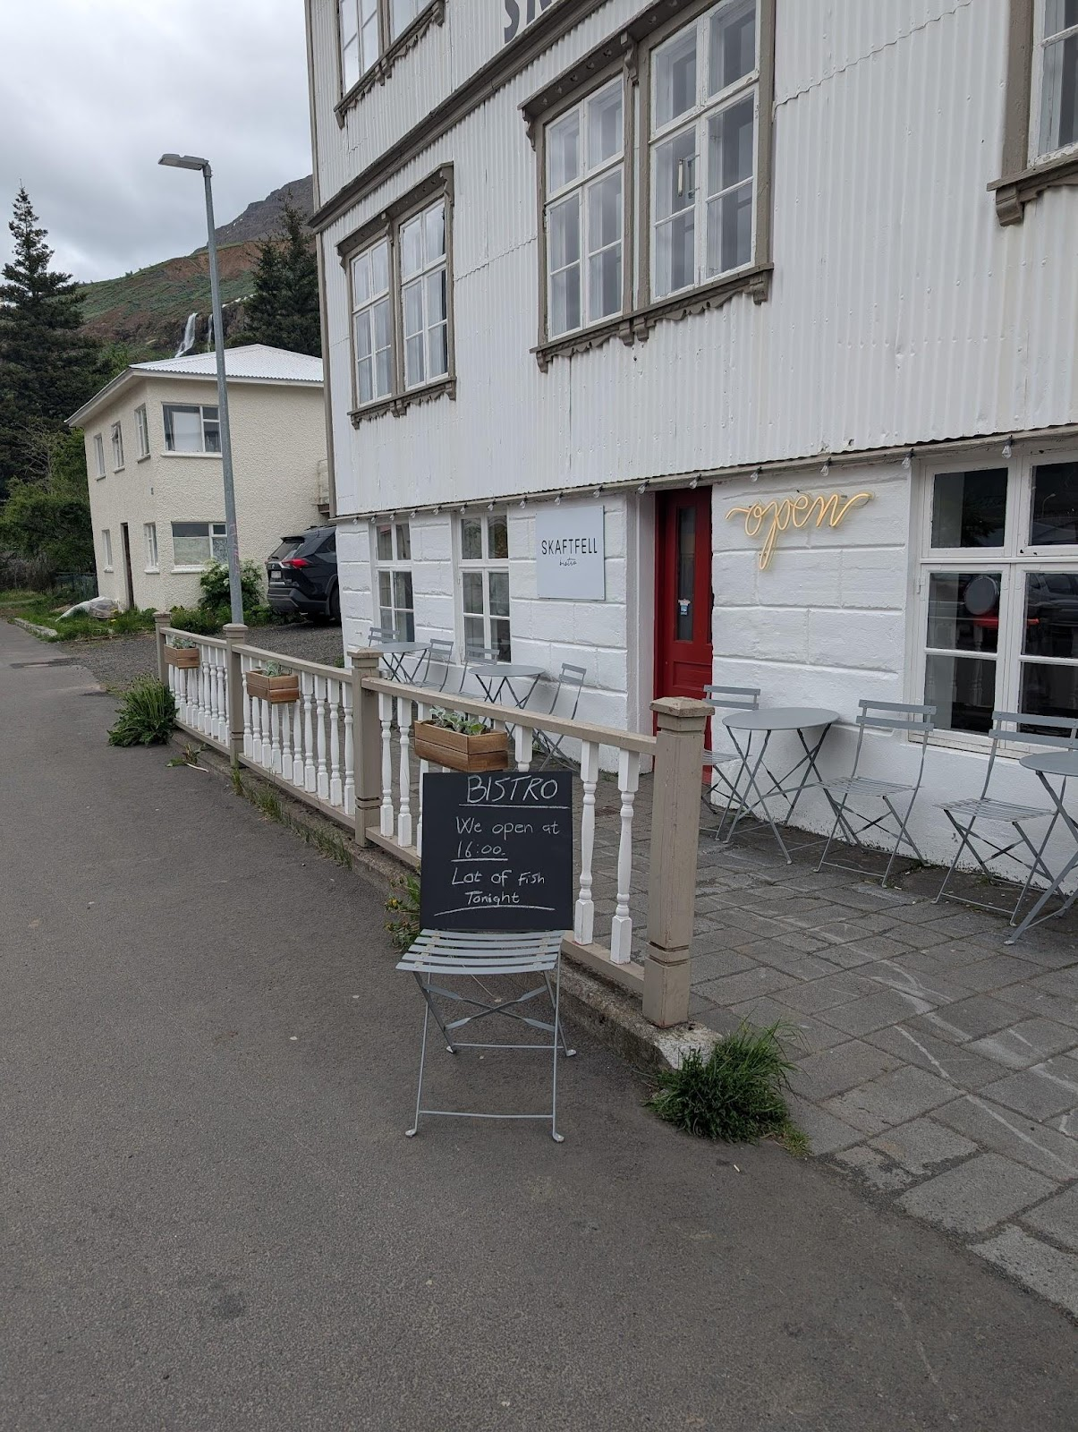
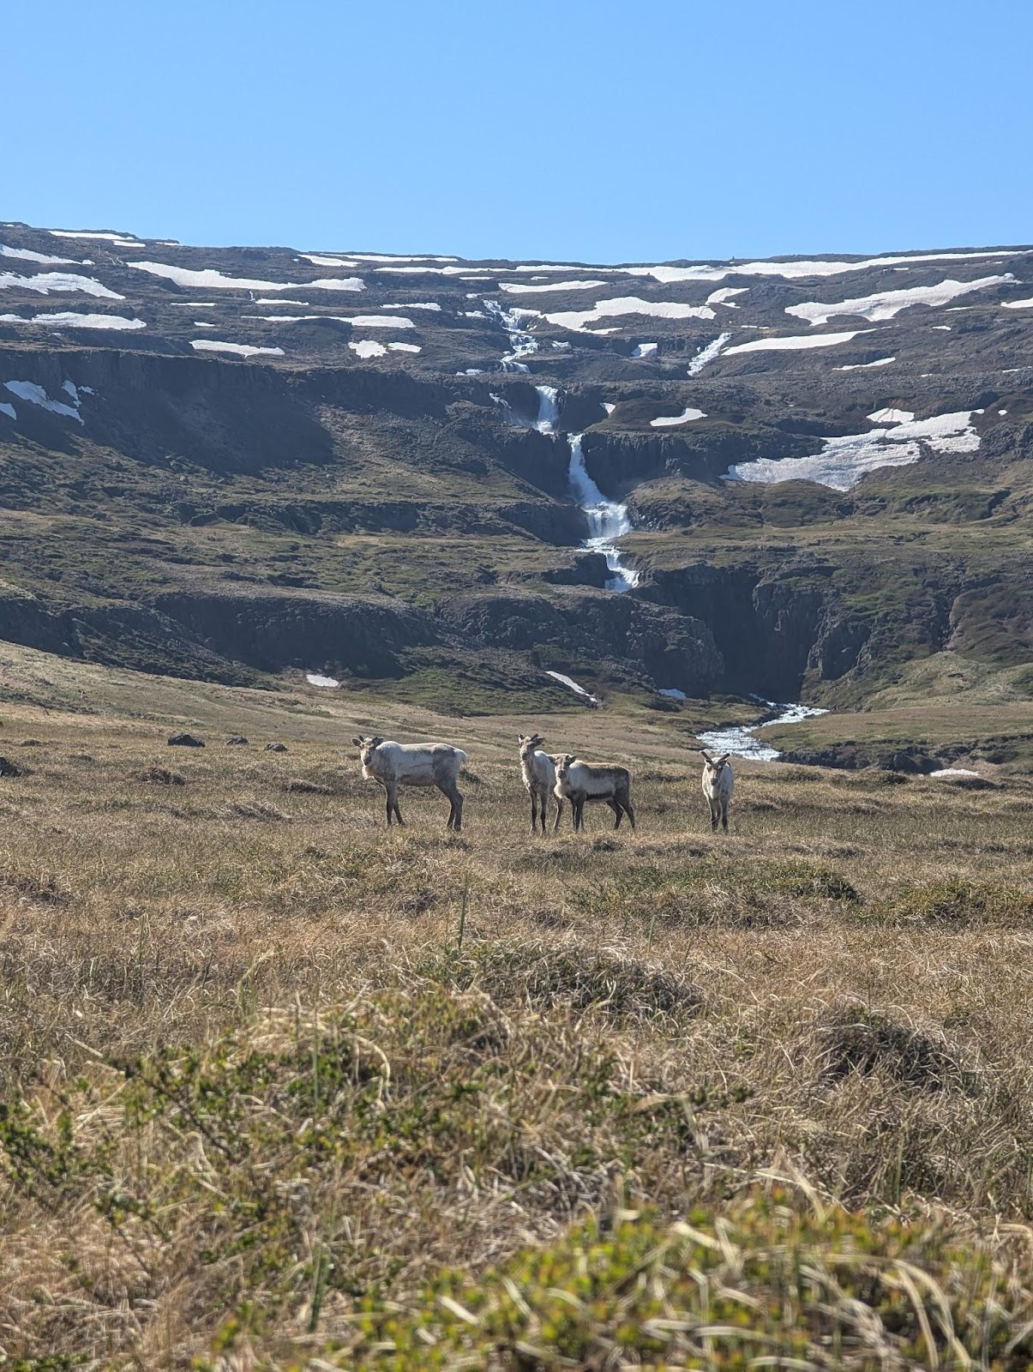
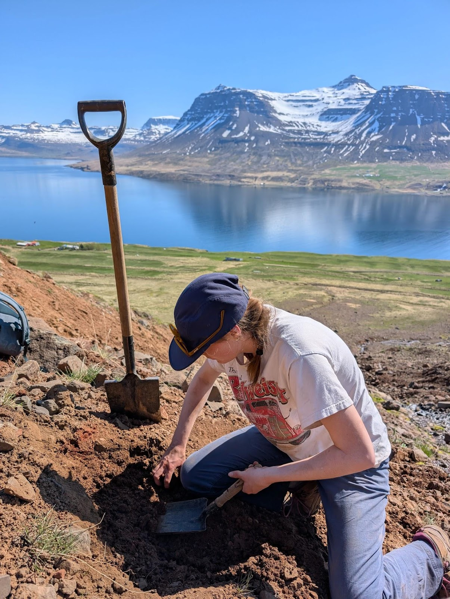
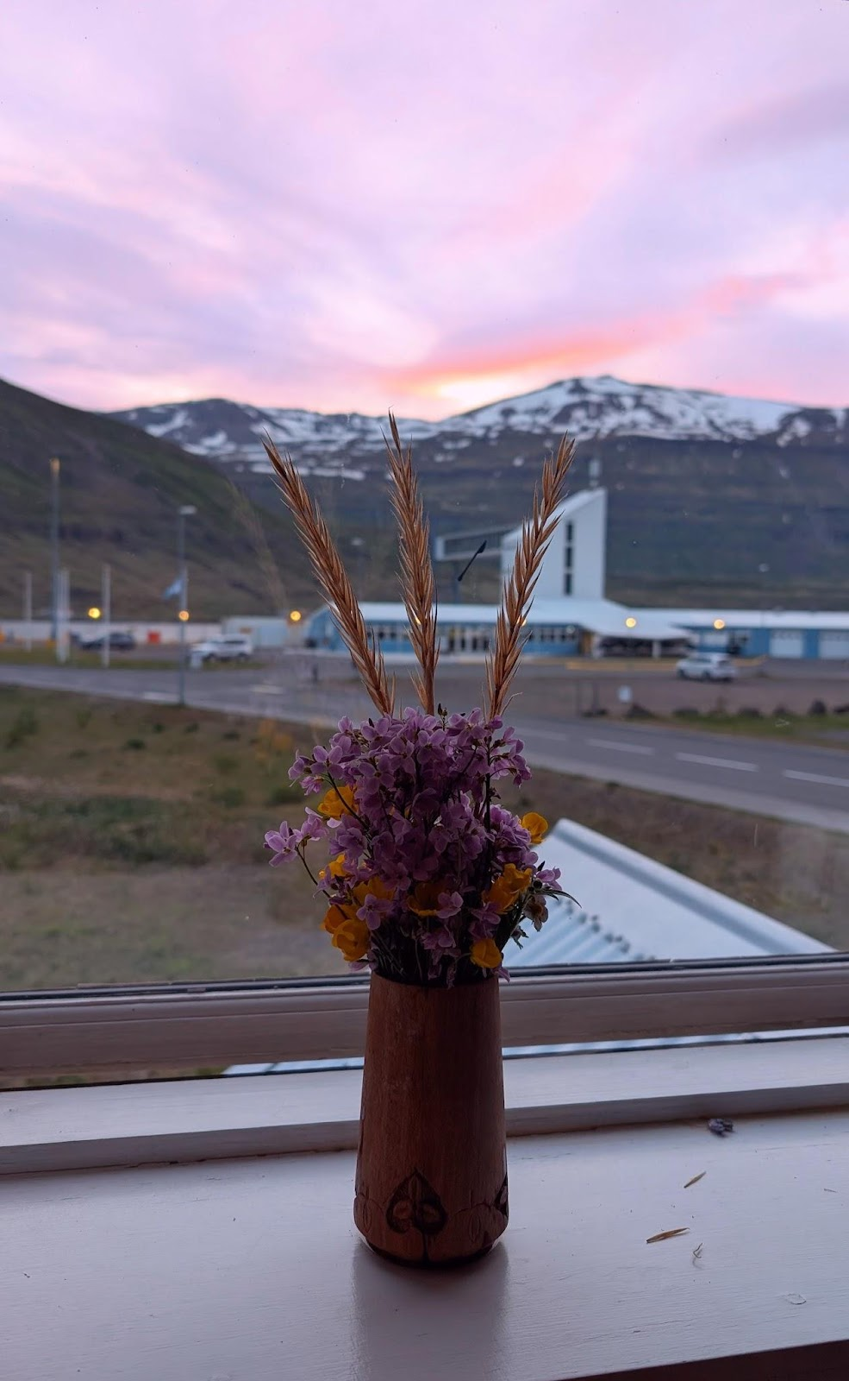
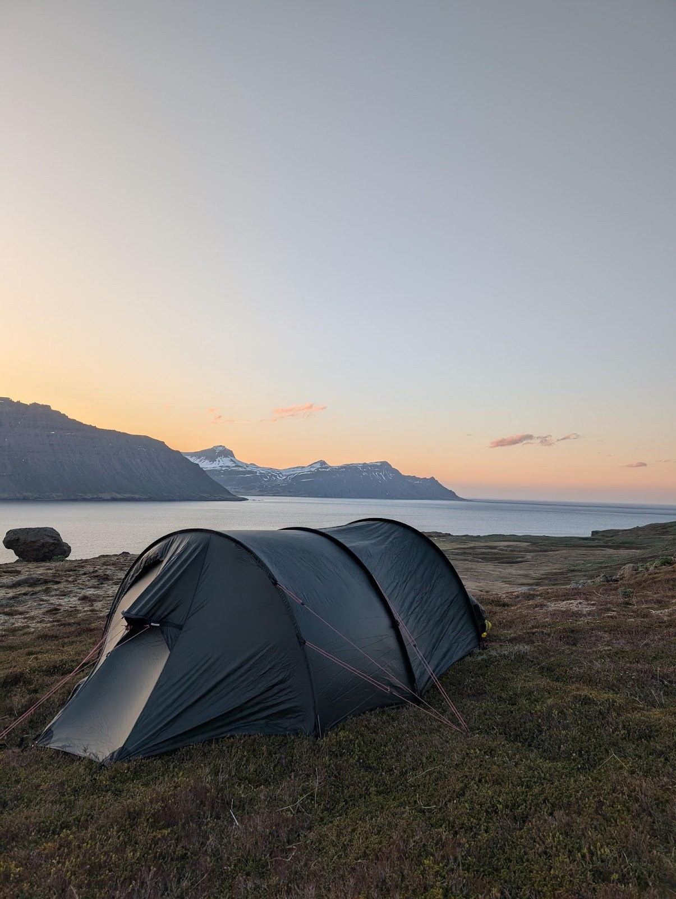
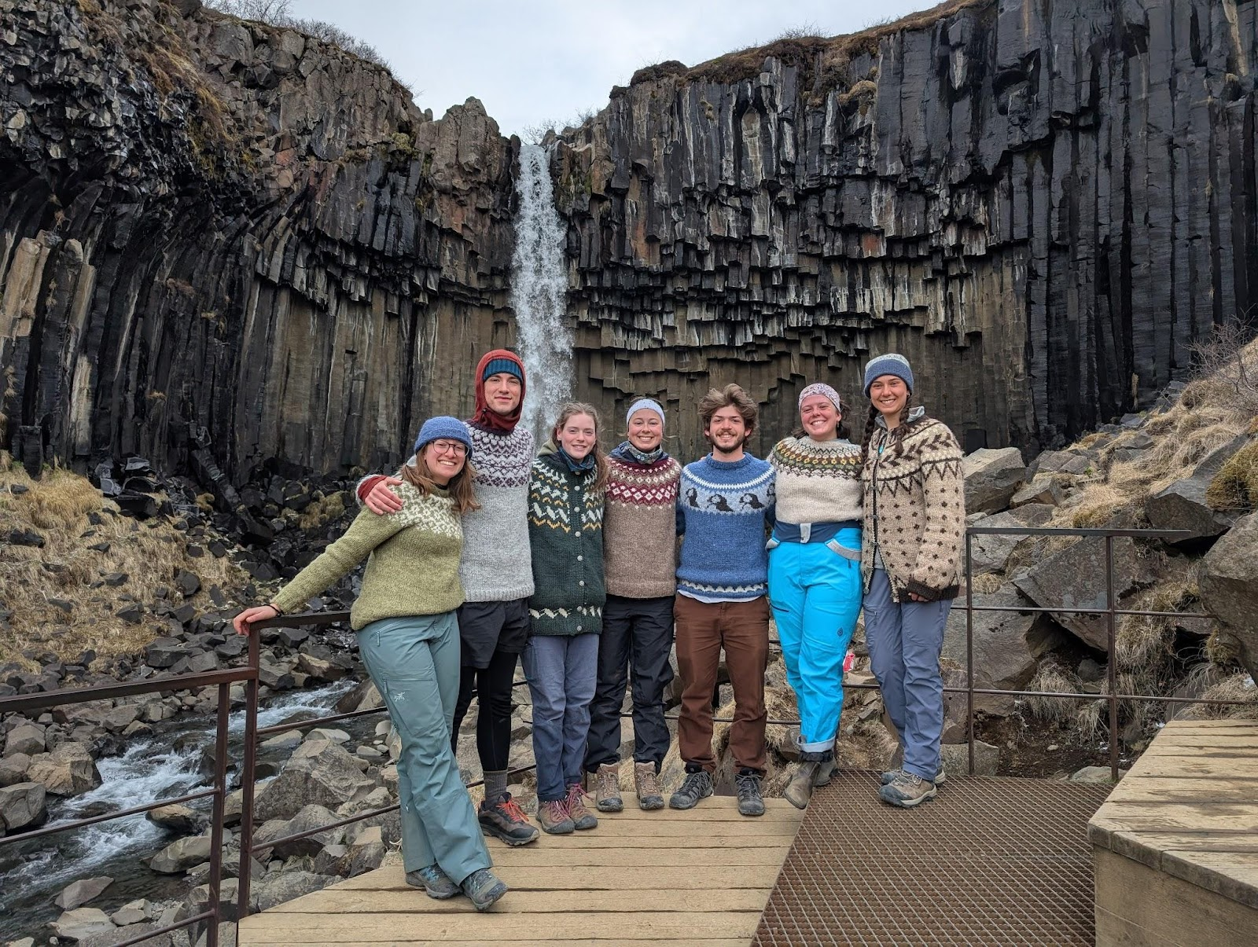
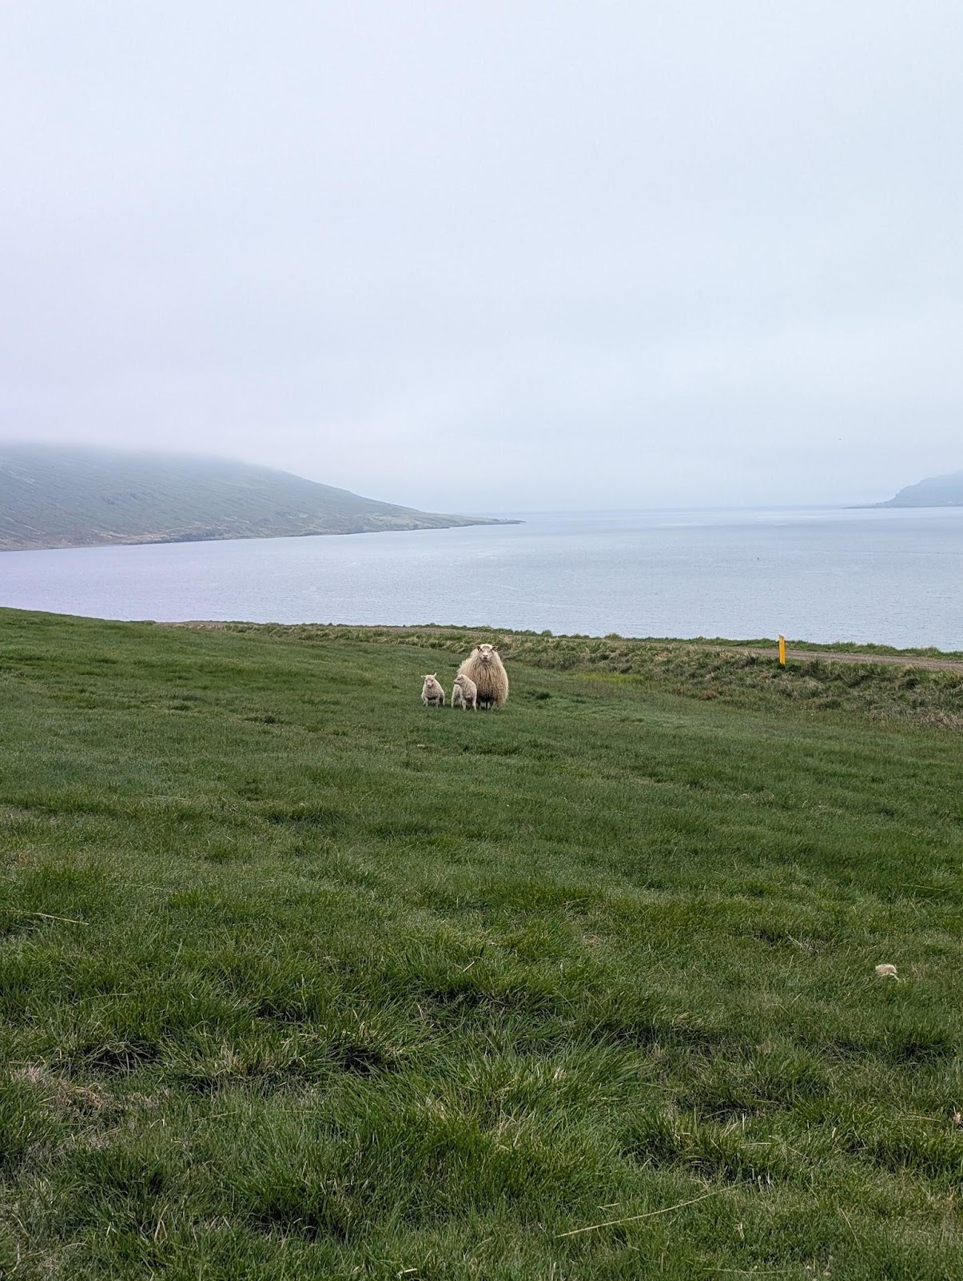
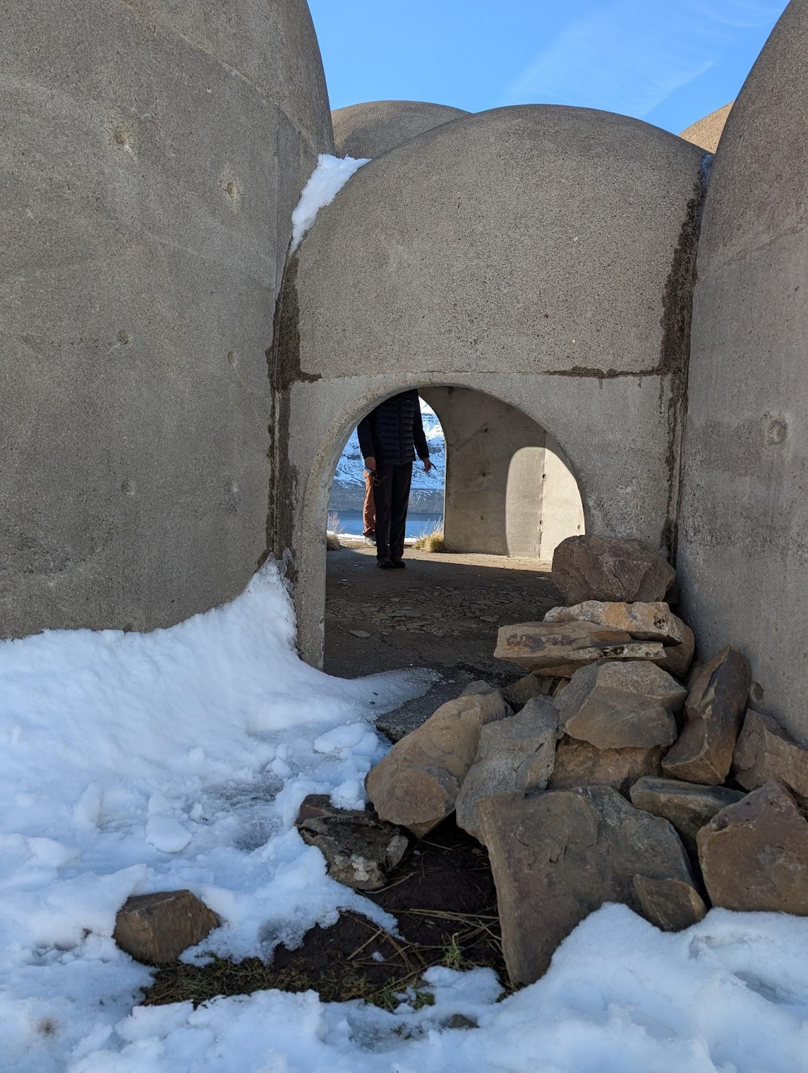
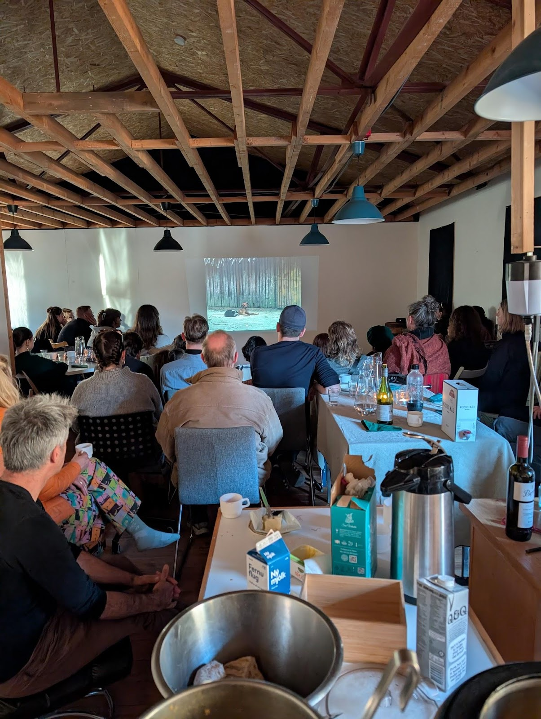

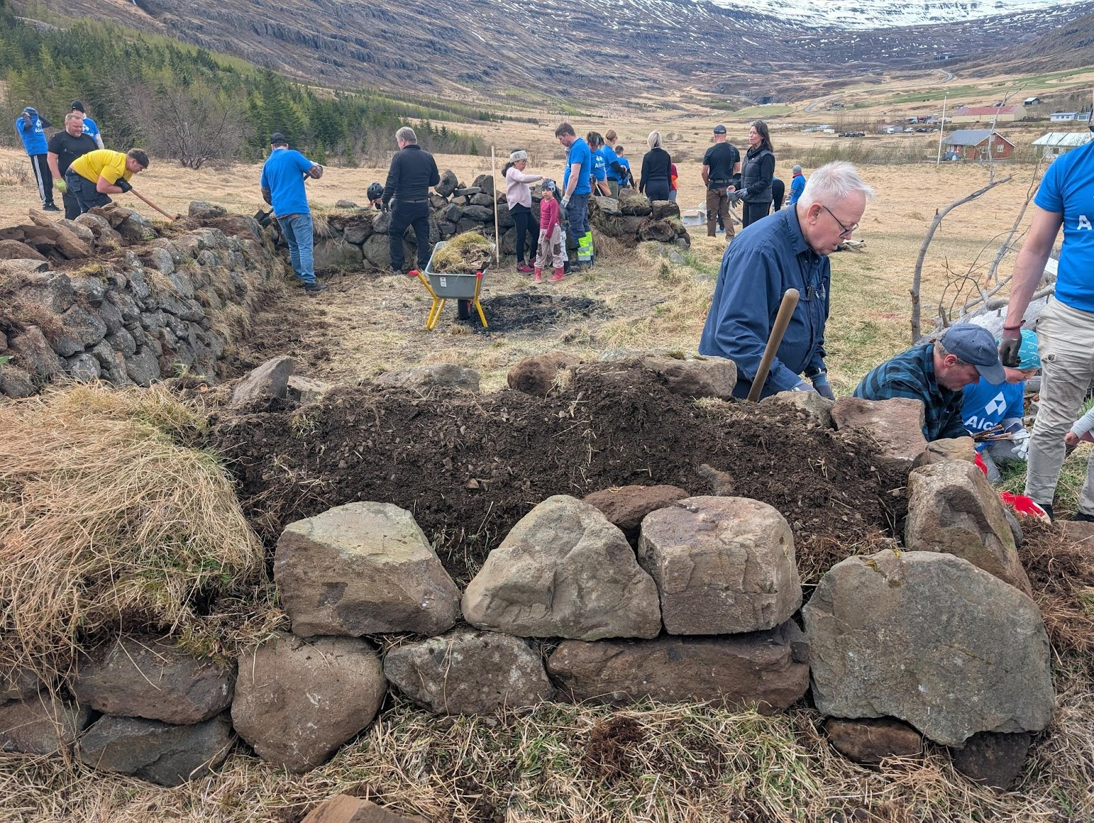
Reflection
Creating something from nothing
“autonomy and agency”
Getting involved in the community

Slide 12
References
Ground penetrating radar (GPR): Advanced subsurface imaging. hydroGEOPHYSICS. (2023, August 31). https://www.hgiworld.com/geophysics-methods/ground-penetrating-radar/
Icelandic Met Office [IMO]. (2021, January 1). The landslide in Seyðisfjörður is the largest landslide to have damaged an urban area in Iceland. https://en.vedur.is/about-imo/news/the-landslide-in-seydisfjordur-is-the-largest landslide-to-have-damaged-an-urban-area-in-Iceland
Natural Science Institute of Iceland - Imagery Viewer. Kortasjá. (n.d.). https://atlas.lmi.is/mapview/?application=loftmyndasja
Perched Aquifer. Groundwater dictionary. (n.d.). https://www.dws.gov.za/Groundwater/Groundwater_Dictionary/index.html?introduction_perched_auifers.htm
Seyðisfjörður Resident (May 9, 2025) Personal Communication.
Stahl, B. (2025). Photos of the Selsstaðir landslides, Seyðisfjörður, and GIS maps. Personal collection.
Theis, S. J. (1979). A flow diagram for teaching texture-by-feel analysis. Wiley Online Library. Retrieved May 20, 2025, from
Weil, R. R., & Brady, N. C. (2017, April). The Nature and Properties of Soils. 15th edition. Research Gate. Retrieved May 20, 2025, from https://www.researchgate.net/publication/301200878_The_Nature_and_Properties_of_Soils_15th_edition

